Slide 1

HTTP Basics
HTTP Request & HTTP Response
SoftUni Team
Technical Trainers
Software University
http://softuni.bg

Slide 2

Table of Contents
HTTP Basics
HTML Forms
HTTP Request
HTTP Response
URL

Slide 3
Have a Question?
sli.do
#fund-common

Slide 4
http://
HTTP Basics

Slide 5



HTTP Basics
HTTP (HyperText Transfer Protocol)
Text-based client-server protocol for the Internet
For transferring Web resources (HTML files, images, styles, etc.)
Request-response based
HTTP request
HTTP response
Web Client
Web Server

Slide 6



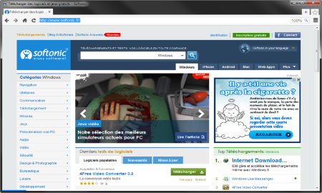





Web Server Work Model
Web Client
Web Server
Technology
Request
Response
Web Resources
Database
HTML, PDF, JPG…

Slide 7
Hyper Text Transfer Protocol
Request
Response
HTTP
HTTP
TCP
TCP
IP
IP
Ethernet
Media (wires / air / fiber)
Ethernet
Notes:
HTTP == Hyper Text Transfer Protocol
Client-server protocol for transferring Web resources (HTML files, images, styles, scripts, data, etc.)
The widespread protocol for Internet communication today
Request-response model (client requests, server answers)
Text-based format (human readable)
Relies on unique resource URLs
Provides resource metadata (e.g. encoding)
Stateless (cookies and Web storages can overcome this)

Slide 8
HTTP Request Methods
Method | Description
POST | Create / store a resource
GET | Read / retrieve a resource
PUT | Update / modify a resource
DELETE | Delete / remove a resource
Other HTTP Methods
CONNECT
HEAD
OPTIONS
TRACE
The four basic functions of persistence storage.

Slide 9

Dev Tools
Tools for Developers

Slide 10
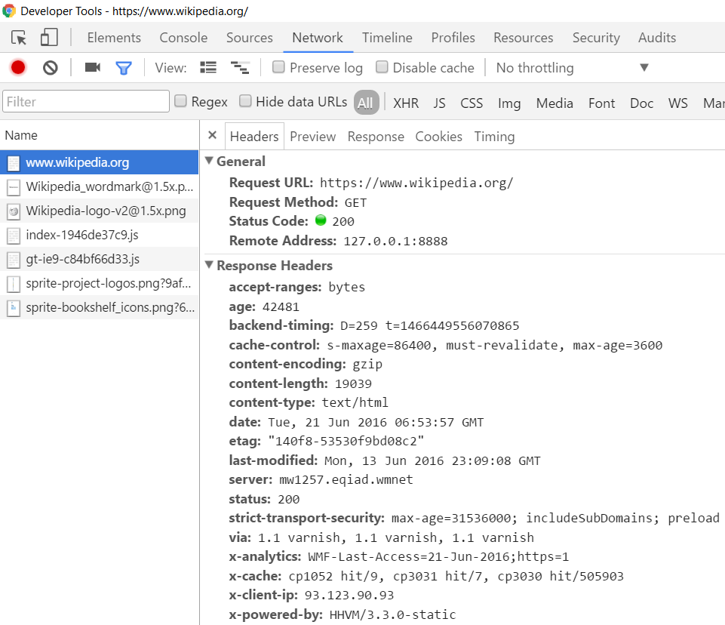

HTTP Developer Tools
Developer Tools
Postman

Slide 11

HTML Forms
Form Method and Action

Slide 12
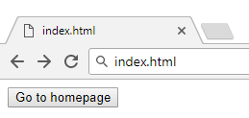
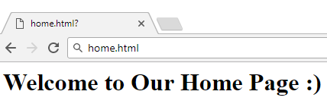
HTML Forms - Action Attribute
Relative URL to the current file
<form action="home.html">
<input type="submit" value="Go to homepage"/>
</form>

Slide 13
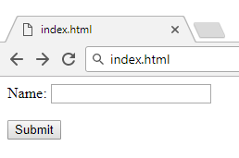
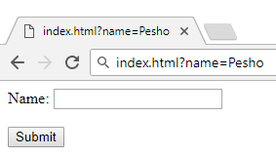
HTML Forms - Method Attribute
Specifies the HTTP method to use when sending form data
<form method="get"> Name: <input type="text" name="name"> <br /><br />
<input type="submit" value="Submit">
</form>
The form data is in the URL

Slide 14
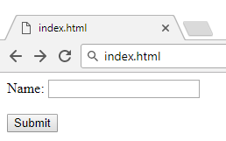
HTML Forms - Method Attribute (2)
<form method="post"> Name: <input type="text" name="name"> <br /><br />
<input type="submit" value="Submit">
</form>
Headers will be explained later
POST http://localhost/index.html HTTP/1.1
Host: localhost
Content-Type: application/x-www-form-urlencoded
Content-Length: 10
name=Pesho
HTTP request body holds the request form data and the response data

Slide 15
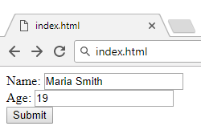
URL Encoded Form Data - Example
<form method="post">
Name: <input type="text" name="name"/> <br/>
Age: <input type="text" name="age"/> <br/>
<input type="submit" />
</form>
POST http://localhost/cgi-bin/index.cgi HTTP/1.1
Host: localhost
Content-Type: application/x-www-form-urlencoded
Content-Length: 23
name=Maria+Smith&age=19
File uploads are not supported

Slide 16

HTTP Request
What is a HTTP Request?

Slide 17






HTTP Request Methods
HTTP defines methods to indicate the desired action to be performed on the identified resource
Method | Description
GET | Retrieve / load a resource
POST | Create / store a resource
PUT | Update a resource
DELETE | Delete (remove) a resource
PATCH | Update resource partially
HEAD | Retrieve the resource's headers

Slide 18
HTTP GET Request - Example
GET /users/SoftUni-Tech-Module/repos HTTP/1.1
Host: api.github.com
Accept: */*
Accept-Language: en
Accept-Encoding: gzip, deflate
User-Agent: Mozilla/5.0 (Windows NT 10.0; WOW64) AppleWebKit/537.36 (KHTML, like Gecko) Chrome/54.0.2840.71 Safari/537.36
Connection: Keep-Alive
Cache-Control: no-cache
<CRLF>
HTTP request line
HTTP headers
The request body is empty

Slide 19
HTTP POST Request - Example
POST /repos/Tech-Module-Jan-2018/test-repo/issues HTTP/1.1
Host: api.github.com
Accept: */*
Accept-Language: en
Accept-Encoding: gzip, deflate
User-Agent: Mozilla/4.0 (compatible;MSIE 6.0; Windows NT 5.0)
Connection: Keep-Alive
Cache-Control: no-cache
<CRLF>
{"title":"Found a bug",
"body":"I'm having a problem with this.",
"labels":["bug","minor"]}
<CRLF>
HTTP request line
HTTP headers
The request body holds the submitted data

Slide 20

HTTP Response
What is a HTTP Response?

Slide 21
HTTP Response - Example
HTTP response status line
HTTP/1.1 200 OK
Date: Fri, 11 Nov 2016 16:09:18 GMT+2
Server: Apache/2.2.14 (Linux)
Accept-Ranges: bytes
Content-Length: 84
Content-Type: text/html
<CRLF>
<html>
<head><title>Test</title></head>
<body>Test HTML page.</body>
</html>
HTTP response headers
HTTP response body

Slide 22
HTTP Response Status Codes
Status Code | Action | Description
200 | OK | Successfully retrieved resource
201 | Created | A new resource was created
204 | No Content | Request has nothing to return
301 / 302 | Moved | Moved to another location (redirect)
400 | Bad Request | Invalid request / syntax error
401 / 403 | Unauthorized | Authentication failed / Access denied
404 | Not Found | Invalid resource
409 | Conflict | Conflict was detected, e.g. duplicated email
500 / 503 | Server Error | Internal server error / Service unavailable

Slide 23
Content-Type and Disposition
The Content-Type / Content-Disposition headers specify how the HTTP request / response body should be processed
Examples:
JSON-encoded data
UTF-8 encoded HTML page. Will be shown in the browser
Content-Type: application/json
Content-Type: text/html; charset=utf-8
Content-Type: application/pdf
Content-Disposition: attachment; filename="Financial-Report-April-2016.pdf"
This will download a PDF file named Financial-Report-April-2016.pdf

Slide 24
HTTP Conversation: Example
HTTP request:
HTTP response:
GET /trainings/courses HTTP/1.1
Host: www.softuni.bg
User-Agent: Mozilla/5.0
<CRLF>
The empty line denotes the end of the request header
HTTP/1.1 200 OK
Date: Tue, 16 Jan 2018 15:13:41 GMT
Server: Microsoft-HTTPAPI/2.0
Last-Modified: Tue, 16 Jan 2018 15:13:42 GMT
Content-Length: 18586
<CRLF>
<html><title>Курсовете от…
</title>

Slide 25

URL
Uniform Resource Locator

Slide 26
Uniform Resource Locator (URL)
http://mysite.com:8080/demo/index.php?id=27&lang=en#lectures
Protocol
Host
Port
Path
Query String
Fragment
Protocol for communicating (http, ftp, https...) – HTTP in most cases
Host or IP address (www.softuni.bg, gmail.com, 127.0.0.1, web)
Port (the default port is 80) – a number in range [0…65535]
Path (/forum, /path/index.php)
Query string (?id=27&lang=en)
Fragment (#lectures) – used on the client to navigate to some section

Slide 27
Query String
Query string contains data that is not part of the path structure
Commonly used in searches and dynamic pages
It is the part of a URL following a question mark (?)
Multiple parameters are separated by some delimiter
http://example.com/path/to/page?name=ferret&color=purple

Slide 28
URL Encoding
URLs are encoded according RFC 1738:
Unreserved URL characters – have no special meaning
Reserved URL characters – can have a special meaning in the URL
Reserved characters are escaped by percent encoding
Space is encoded as "+" or "%20"
[0-9a-zA-Z]
! * ' ( ) ; : @ & = + $ / , ? # [ ]
%[character hex code]

Slide 29
URL Encoding - Examples
All other characters are escaped by %
Char | URL Encoding
space | %20
щ | %D1%89
" | %22
# | %23
$ | %24
% | %25
& | %26
Each character is converted to its ASCII value, represented as hexadecimal digits
Наков-爱-SoftUni
%D0%9D%D0%B0%D0%BA%D0%BE%D0%B2-%E7%88%B1-SoftUni

Slide 30
Valid and Invalid URLs - Examples
Some valid URLs:
Some invalid URLs:
http://www.google.bg/search?sourceid=navclient&ie=UTF-8&rlz=1T4GGLL_enBG369BG369&q=http+get+vs+post
http://bg.wikipedia.org/wiki/%D0%A1%D0%BE%D1%84%D1%82%D1%83%D0%B5%D1%80%D0%BD%D0%B0_%D0%B0%D0%BA%D0%B0%D0%B4%D0%B5%D0%BC%D0%B8%D1%8F
Should be: C%23+.NET+4.0
http://www.google.bg/search?&q=C# .NET 4.0
Should be: %D0%B1 %D0%B8%D1%80%D0%B0
http://www.google.bg/search?&q=здравей

Slide 31

Summary
HTTP works with message pairs HTTP request and HTTP response
The URL parts define:
protocol, host, port, path, query string, and fragment
…
…
…
GET /trainings/courses HTTP/1.1
Host: www.softuni.bg
User-Agent: Mozilla/5.0
<CRLF>
HTTP/1.1 200 OK
…
<CRLF>
<html><title>…

Slide 32
https://softuni.bg/modules/fundamentals-module

Slide 33












SoftUni Diamond Partners

Slide 34




SoftUni Organizational Partners

Slide 35




Trainings @ Software University (SoftUni)
Software University - High-Quality Education and Employment Opportunities
softuni.bg
Software University Foundation
http://softuni.foundation/
Software University @ Facebook
facebook.com/SoftwareUniversity
Software University Forums
forum.softuni.bg

Slide 36

License
This course (slides, examples, demos, videos, homework, etc.) is licensed under the "Creative Commons Attribution-NonCommercial-ShareAlike 4.0 International" license

